Slide 1





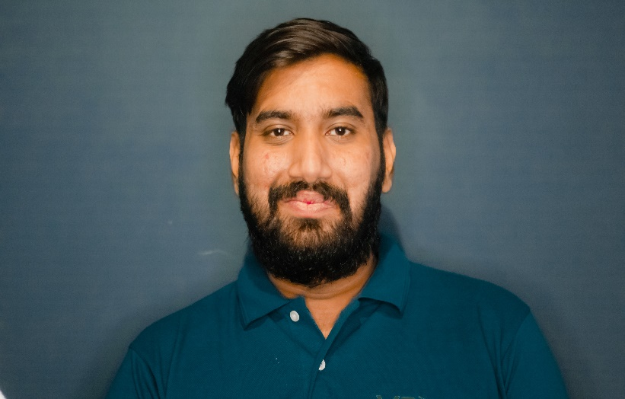


2024
20B-124-CS SYED HAMZA HODA
20B-122-CS MUHAMMAD RAYYAN

Slide 2
EXECUTIVE SUMMARY
In the ever-evolving landscape of digital services, Eversoft emerges as a dynamic and innovative solution provider, offering a comprehensive suite of services tailored to meet the digital needs of our clients. Our business model revolves around four key areas: Product/Industry, Target Market, Sales Channel, and a unique "Creative Collaboration" approach.

Slide 3

ABOUT OUR COMPANY
Eversoft specializes in a diverse range of services, covering Academic Writing, Essay & Content Writing, Graphic Designing (Logo Design, Banner, Poster), Social Media Management, and Web Designing. By catering to both academic and business sectors, we position ourselves as a versatile entity in the digital service industry, addressing the distinct needs of our clientele.

Slide 4
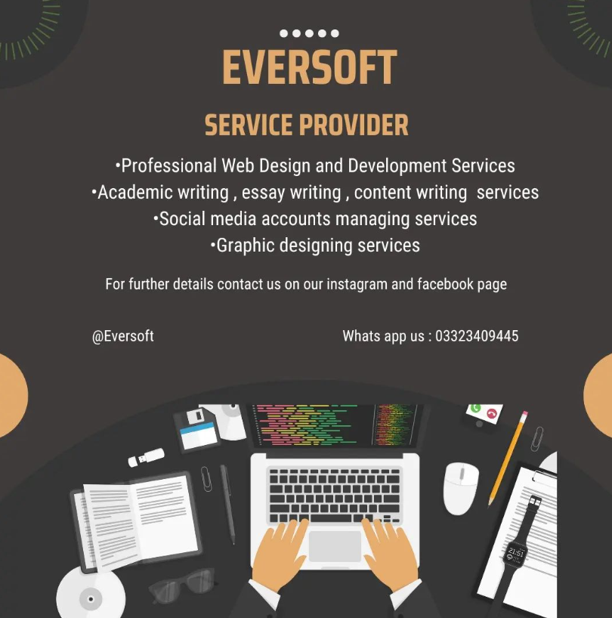
WHAT WE OFFER
Academic writing:
Essay and content writing.
2. Design & Creative:
Graphic designing, logo, banner and poster designing.
3. Web & App Development:
Creating website and app for any business.
4. Social Media Management
Handling all social platforms of different businesses

Slide 5

OUR VALUES
MISSION:
Empower individuals and businesses by providing top-notch digital services that exceed expectations. We aim to deliver excellence through a blend of creativity, innovation, and client collaboration.
VISION:
In the next 5 years, we envision becoming a leading name in the digital service industry, known for our innovative approach and commitment to client satisfaction.

Slide 6
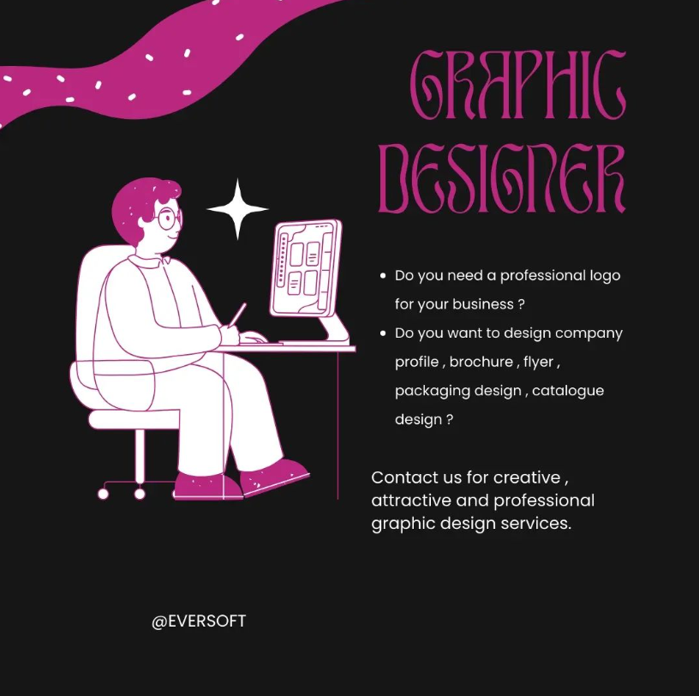

TARGET MARKET
Our target market encompasses a wide spectrum. For academic services, we cater to students and professionals seeking top-notch writing solutions. In the design realm, our services are geared towards businesses and individuals looking for creative and impactful visual content. Specifically, our academic writing services resonate with students and professionals, while our design services appeal to businesses aiming for a strong and visually appealing online presence.

Slide 7
MAKET ANALYSIS
Businesses and people have a new craving: It's not just about fancy offices and water coolers anymore. This market is exploding, projected to reach a colossal $375 billion by 2027, driven by several key factors.
Think students drowning in homework? Online education is booming, and competition for college spots is fierce. That's why the demand for professional writing support has jumped 38% in just one year
Businesses lost in the social media jungle? They're not alone. With social media being the new battleground for brand awareness and customer engagement, demand for social media management has soared 27% (Clutch, 2023).
In the digital age, attention spans are shorter than ever before. That's why eye-catching graphic design is king. The market for logos, website visuals, and marketing materials is expected to reach a cool $60.7 billion by 2028 (Market Research Future, 2023).

Slide 8
SWOT ANALYSIS
STRENGTHS:
Diverse portfolio
Expert Personnel
Online Platform
WEAKNESSES:
Market Recognition
Dependence on personnel
OPPORTUNITES:
Growing digital services
Social Media Growth
THREATS:
Intense competition
Technological Changes

Slide 9
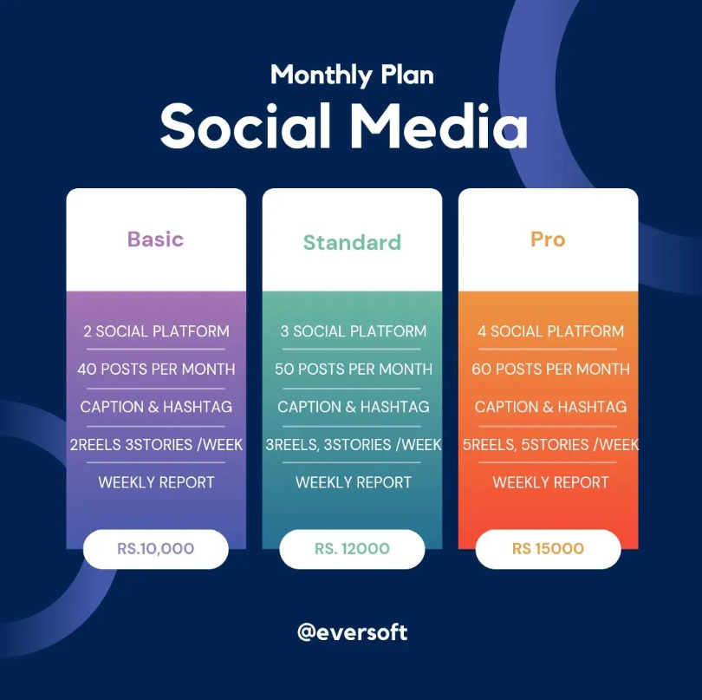
DIFFERENT PLANS

Slide 10
CONCLUSION
Eversoft's market research survey reveals a significant demand for high-quality, tailored expert services across academic writing, graphic design, social media management, and web design. Clients prioritize clear communication, subject-specific expertise, and features that address their specific challenges and project requirements. By focusing on personalized solutions, quality assurance, and a client-centric approach, Eversoft can differentiate itself in a competitive market and gain the trust and loyalty of potential clients.

Slide 11


THANK YOU

